Slide 1

Enhancing the Future Prospects for Placement
Presented By:
S. Lavan Karthik (2011CS010266)
P. Kaushik Varma (2011CS010218)
P. Jayanth (2011CS010216)
P. Yagnesh (2011CS010244)
Under the guidance of Dr. K. Asish Vardhan

Slide 2
Introduction
In today's competitive job market, students and job seekers often face challenges in securing suitable placements or job opportunities. To address this issue, machine learning techniques can be employed to predict the likelihood of a candidate's placement success based on their profile and qualifications.
This project aims to combine the power of machine learning algorithms with the convenience of an Android application to assist students and job seekers in predicting their chances of getting placed.
The project will be implemented using the Android Studio development environment, which offers a rich set of tools and libraries for Android app development.

Slide 3
Problem Statement
The problem we aim to solve is the uncertainty and lack of information faced by students and job seekers regarding their placement prospects. With numerous factors influencing the placement process, including qualifications, skills, and industry trends, it becomes challenging for individuals to assess their chances of getting placed accurately. Key Challenges:
Data Collection and Preprocessing
Feature Selection and Engineering
Model Selection and Training
Integration with Android Studio

Slide 4
Objective of project
The primary objective of this project is to develop a placement prediction system using machine learning techniques and integrate it into an Android application. The project aims to provide students and job seekers with a tool that can accurately predict their chances of securing a job placement based on their qualifications and profile.
Data Collection and Preprocessing
Feature Selection and Engineering
Machine Learning Model Training
Android Application Development

Slide 5
Existing systems
The existing system for placement prediction using machine learning and Android Studio aims to provide individuals with valuable insights into their job placement prospects. The system utilizes machine learning algorithms and leverages the capabilities of Android Studio to develop a mobile application that assists individuals in making informed decisions regarding their career path.In the existing system, relevant data about individuals, such as academic performance, technical skills, internships, and extracurricular activities, is collected. This data is preprocessed to ensure its quality and compatibility with machine learning algorithms. Steps like handling missing values, encoding categorical variables, and normalizing numerical features are performed during the preprocessing phase.

Slide 6
Limitations of the existing system
High false positives: There is no interactive tool for users to check for their attrition.
Technology Complexity: Most of the system is complex to understand, and not user-friendly as compared to our proposed system.
Time-Consuming Feature: In the existing system, the performance is low and most of the time system gets hung due to load.
Not Easy to Understand: Systems are complex to understand and they were not user-friendly.

Slide 7
Proposed system
The proposed system aims to overcome the limitations of the existing system by leveraging machine learning techniques and the development capabilities of Android Studio.
The key components and features of the proposed system are as follows:
Data Collection and Preprocessing: Gather comprehensive and relevant historical placement data from various sources, including previous placement records, student profiles, and industry trends.
Feature Selection and Engineering: Analyze the collected data to identify the most influential features that contribute to successful placements.

Slide 8
Software requirements
Android Studio: The integrated development environment (IDE) for Android application development.
Java: Programming languages used for Android app development.
Android Software Development Kit (SDK): Provides tools and libraries for building, testing, and debugging Android applications.
Jupyter Notebook: This is used for building machine learning models.
AWS(EC2 Server): It is used for deploying the project in the server which builds FastAPI using pickle and python files.

Slide 9
Hardware requirements
Processor: minimum 1 GHz or more.
Ethernet connection (LAN) OR a wireless adapter (Wi-Fi).
Hard drive: Minimum 32 GB ;Recommended 64 GB.
Memory (RAM): Minimum 1 GB; Recommended 4 GB

Slide 10
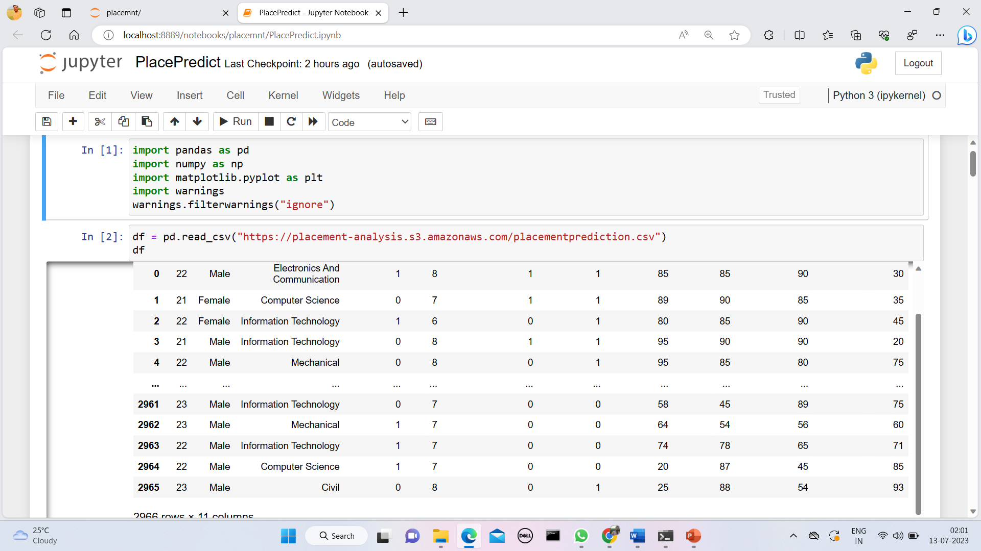
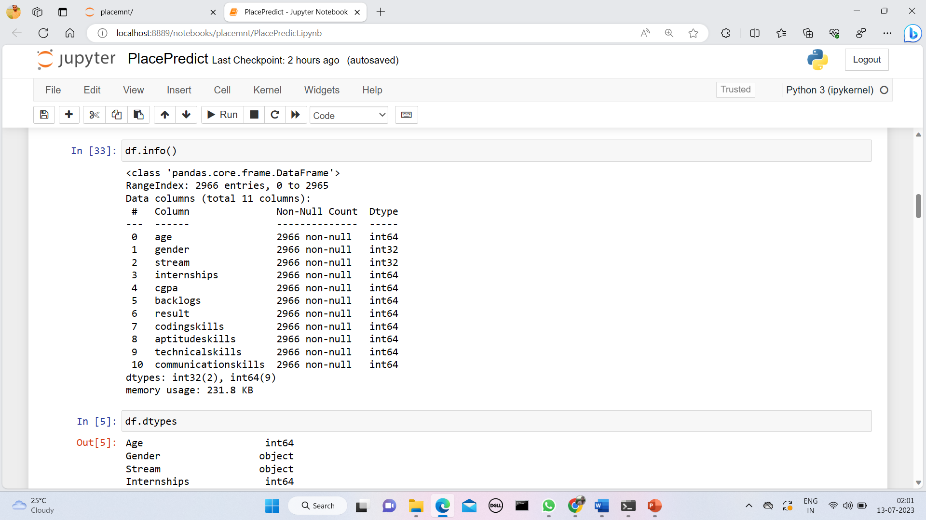
Python code in jupyter

Slide 11
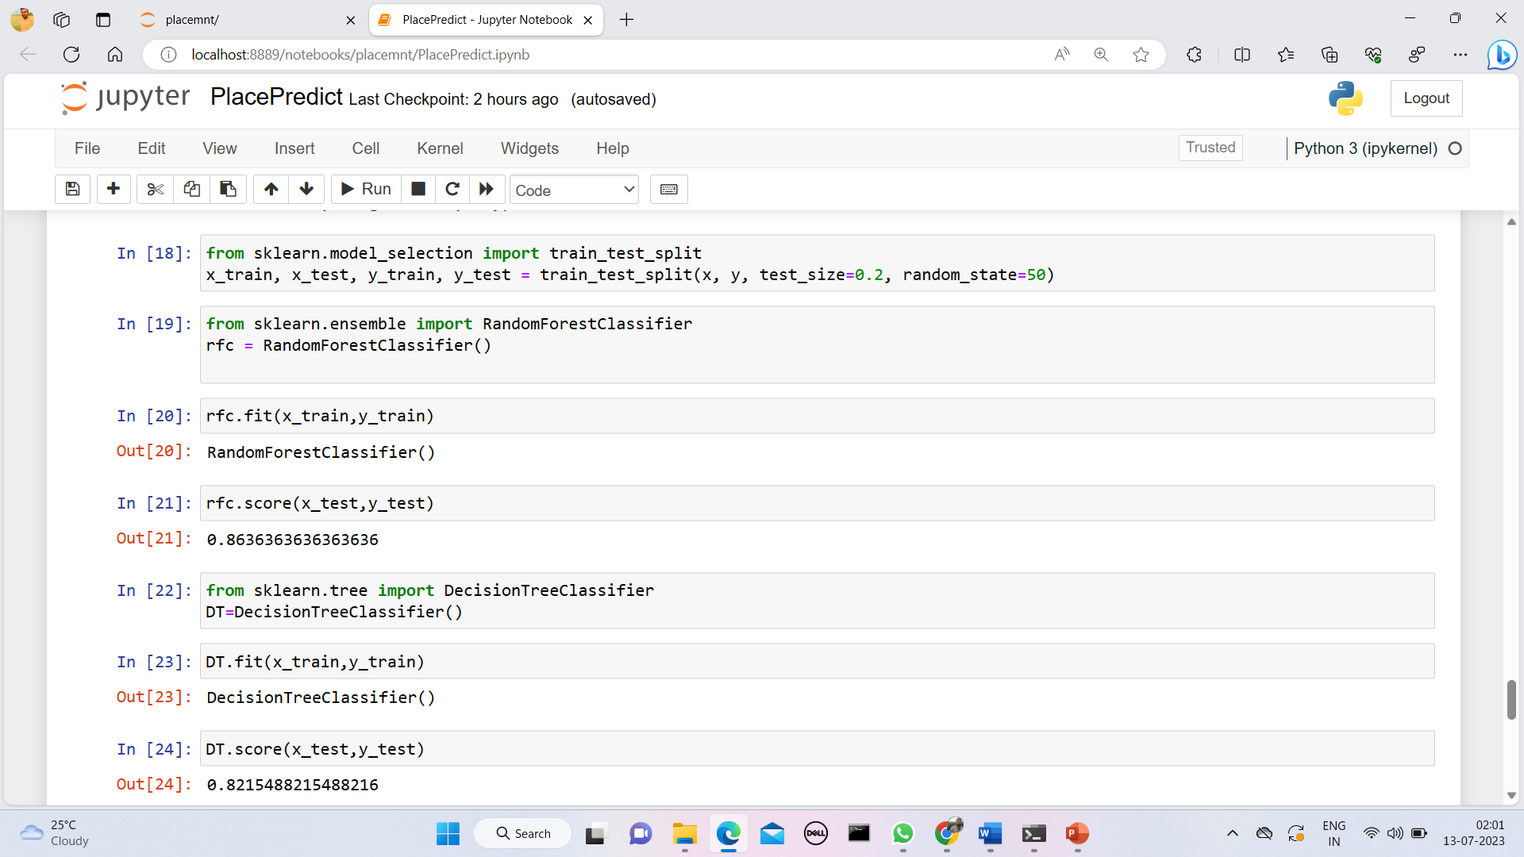
Implementation of the algorithm

Slide 12
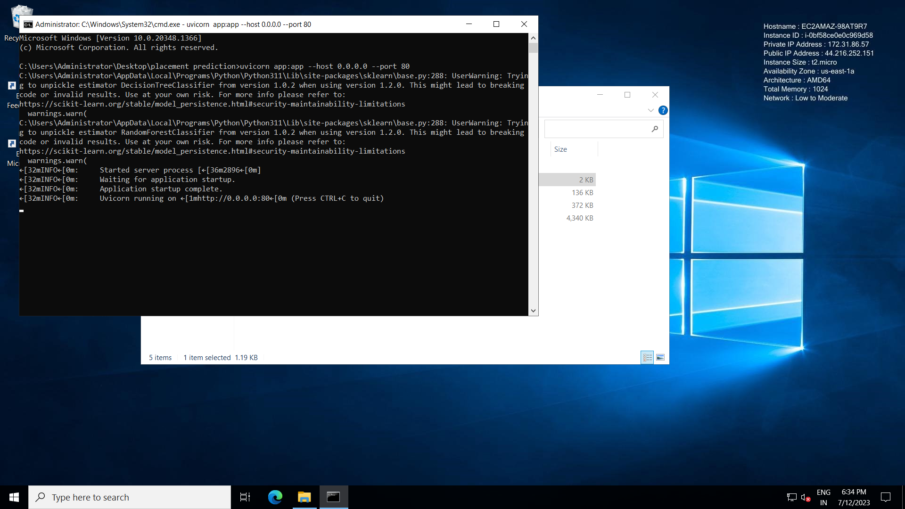
Fastapi running in the server

Slide 13

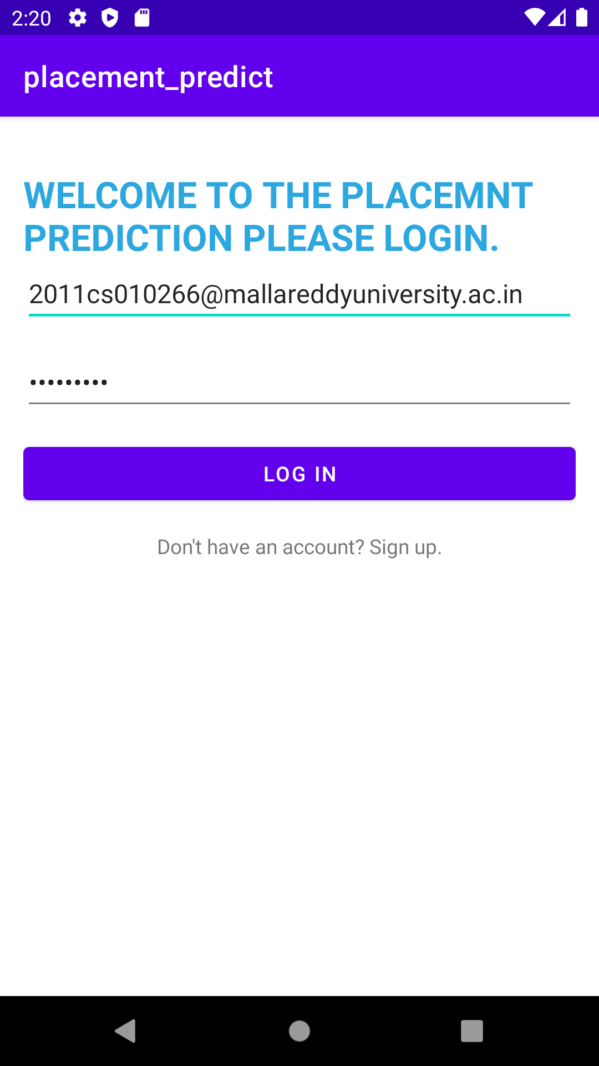
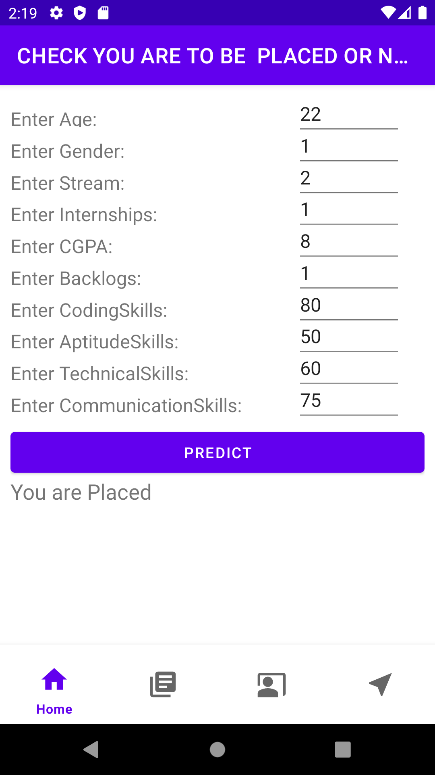
Output

Slide 14
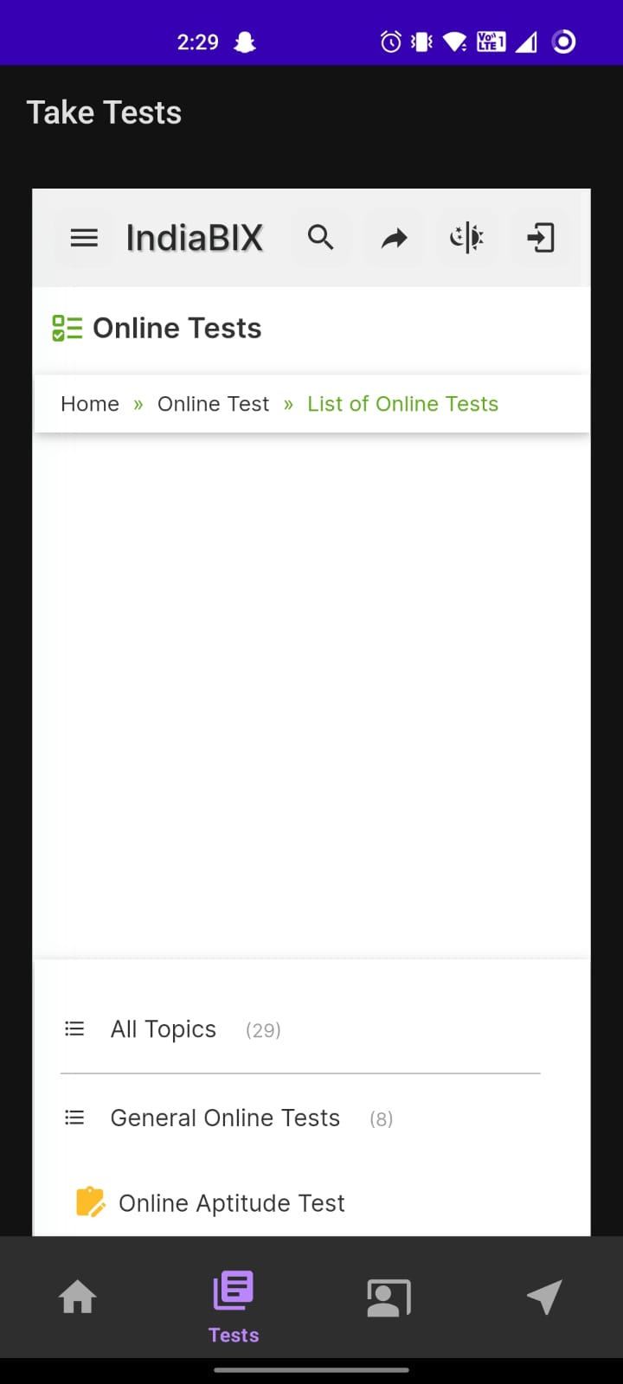
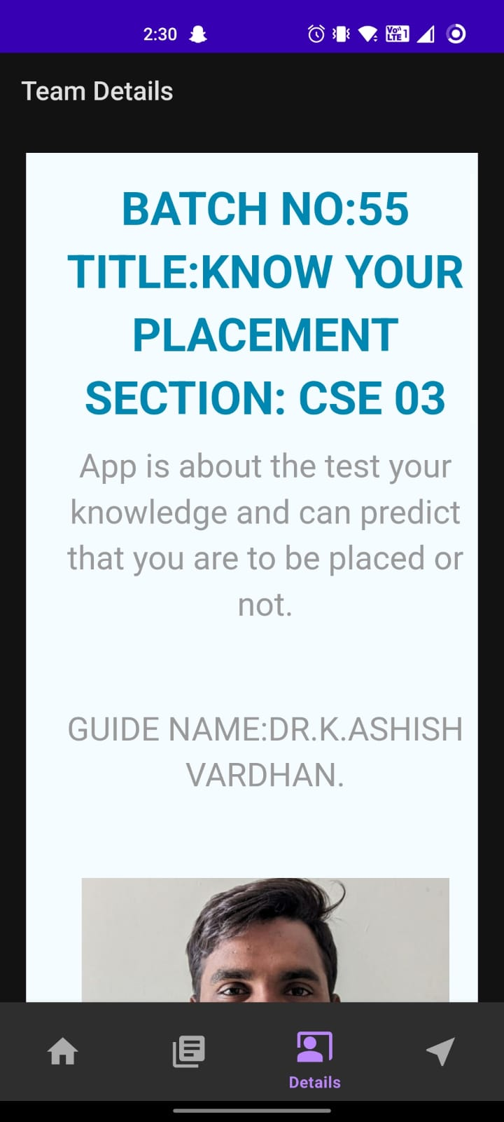

Slide 15

Conclusion
The placement prediction system developed using machine learning techniques and Android Studio offers significant benefits to students and job seekers in assessing their chances of securing a job placement. By leveraging historical placement data and user profiles, the system provides accurate predictions and valuable insights to help individuals make informed decisions about their career choices.

Slide 16
THANK YOU

